Slide 1
Data literacy
By Marlon Durand

Slide 2

What I Intended to accomplish
I hope to give everyone a better understanding out data literacy and showing what makes an effective visualization of data. As well as breaking down the aspects of data literacy and how to implement them.

Slide 3
What is Data Literacy
Data literacy is the ability to read, understand, create, and communicate data as information. Much like literacy as a general concept, data literacy focuses on the competencies involved in working with data. For most the hardest part of data literacy is communicating or presenting the data properly.

Slide 4
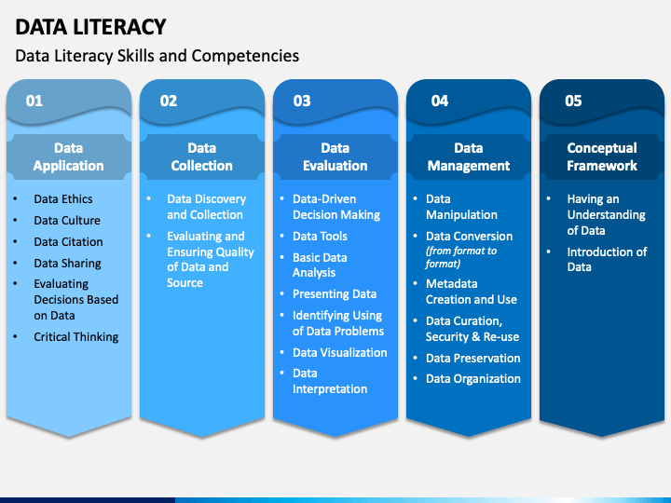

Slide 5
Main aspects of Data Literacy
1
Working with people
2
Knowing what data is appropriate to use for a particular purpose.
3
Thinking critically about information yielded by data analysis.
You have to be able to Explain what you are analyzing to others. A big part of data Literacy is communicating the data to others. To insure that there is no misinterpretation of the data
Knowing what data is relevant to your target audience is vital in business. As well as being able to decide on how to display the data in the most effective way possible.
Being able to look at the data at hand and break it down into individual pieces to better grasp the concept and check for error. As well questioning where the data originates from.

Slide 6
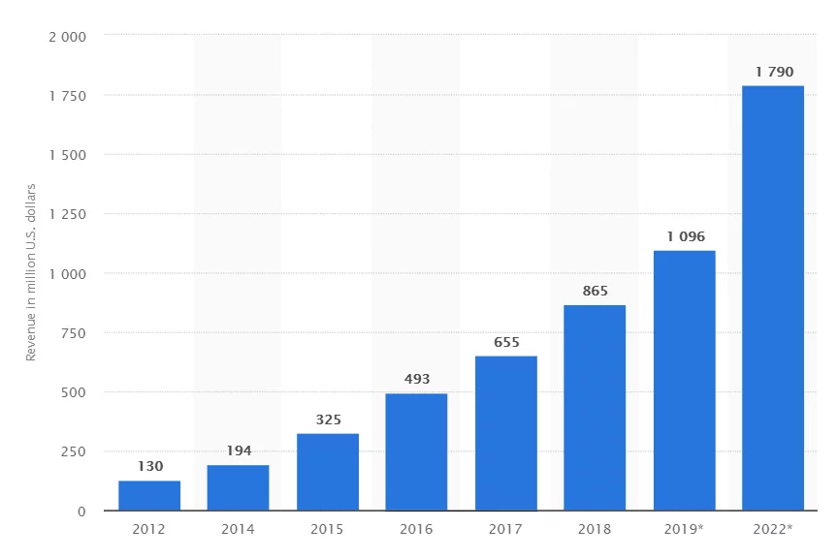
Examples

Slide 7
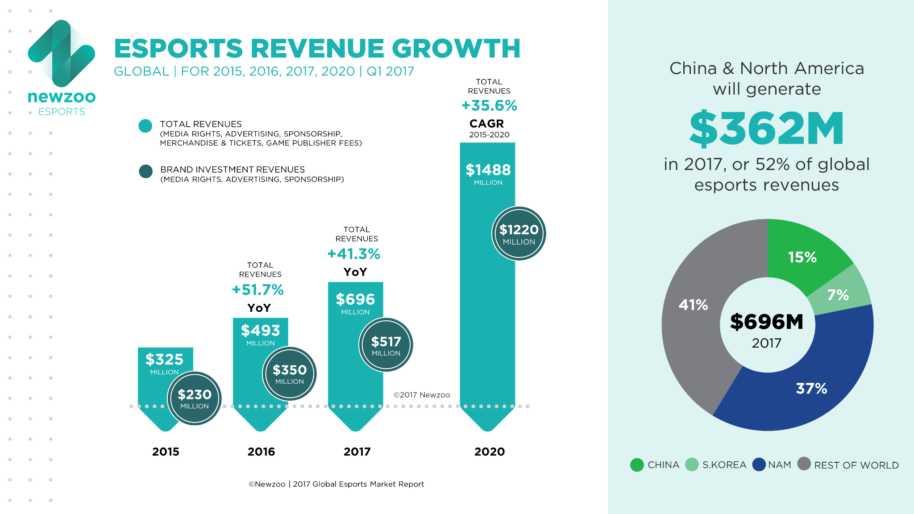

Slide 8


Compare & Contrast
The first graph though not bad isn't great it lacks more color variety as well as a legend that can effectively break down the graph. The graph leaves you to place all the data yourself to make any further connections.
The second graph has a legend as well as breaks down the present the revenue has grown within that year. As well as adding a pie chart to show were the revenue came from.

Slide 9
Citations
https://influencermarketinghub.com/esports-stats/
https://www.altchar.com/game-news/esports-revenues-will-break-1.1-billion-in-2019-aqi5o4L5bfRs
https://mitsloan.mit.edu/ideas-made-to-matter/how-to-build-data-literacy-your-company
https://www.sketchbubble.com/en/presentation-data-literacy.html

